Slide 1
Symmetrical Games of Perfect and Imperfect coordination
By Joshua Jolly

Slide 2
Design of Program
Set up game payoffs
Open data
Begin turn
Find a list of all interactions that happen
Decide what to do with each player
If random, choose random number and weight answer
For learning algorithm, check interaction history and calculate best response
Then record history
Calculate strategy matrix/decision matrix
Display data

Slide 3
Why is the program beneficial?
Because it allows quick ceterus paribus testing (you can change the algorithm, learning options, etc. instantly)
Because it has a visual component, making it easy to see patterns.
Because it is dynamic and can be changed on-the-fly (for example, grim can actually be implemented because each turn can have a new algorithm inserted).
It is very extensible as well, can be added to quite easily if properly modulated and unit tested.
Very few dependencies (numpy, standard python distributions in both 2.7 and 3.2, and works on WIN32 machines.)

Slide 4

How do we know who is INTERACTING with whom?
Because this can change, needs to be detected every turn.
In a grid, there are eight directions. Reading left to right (and skipping any numbers with zero) all we have to do is detect 4 of them. Those 4 are always unique. How cool is that?
So I just iterated through each, one by one, and made a master list of interactions. Then I calculated each player’s strategy, and I knew the outcome of every single interaction with 100% certainty. Only had to calculate each interaction once.

Slide 5


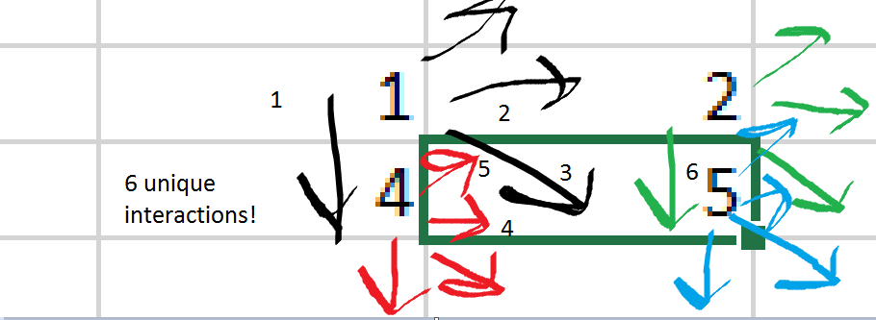

Slide 6
How does the learning algorithm work?
At first, it cooperates for 2 turns to prevent unnecessarily quick defecting.
It records the historical average of each conflict by turn (if it interacted with 8 people that implies the average is # of A’s divided by number of conflicts).
This is recorded in a virtually unlimited history, but I capped it at 8 and take a sample of 6 every time it exceeds that [show algorithm].
Then, based on that pseudo-mixed strategy opponents played, calculate best response and play the best response. For example, if strategy is past basin of attraction (at .666666A+.3333333B in the stag hunt), the algorithm will calculate B as the best response.

Slide 7
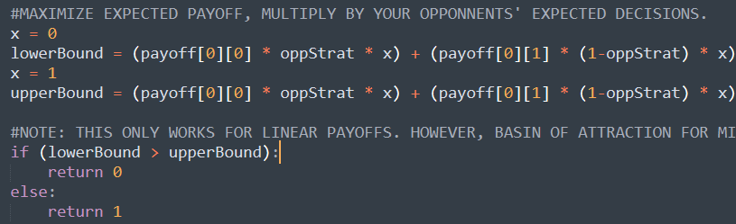
How do you know a mixed equilibrium doesn’t have a higher expected value?
This is a great optimization for my program that I found. Let’s imagine that we are playing a 2 player game with some arbitrary payoffs. You have evidence that your opponent is playing A 50% of the time in a mixed strategy. Further, you know that the mixed nash equilibria exists at .4A+.6B.
In my program, I do not attempt to derive any higher payoffs, I only check payoffs at X=0 and X=1.
Why is that?
The answer is because the payoffs are always linear. Because expected value is calculated using (the payoff * x * opponents probability to choose x) at (A,A), and that number is summed with the others there is no opportunity to have it be nonlinear. X is the only variable and is never multiplied with itself. Because it is always linear, you need only use a Boolean operator to compare the payoffs. You do not need to take the derivative. The mixed strategy should, therefore, never have a basin of attraction.

Slide 8
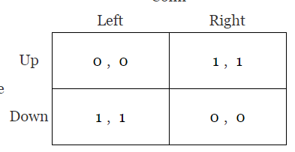
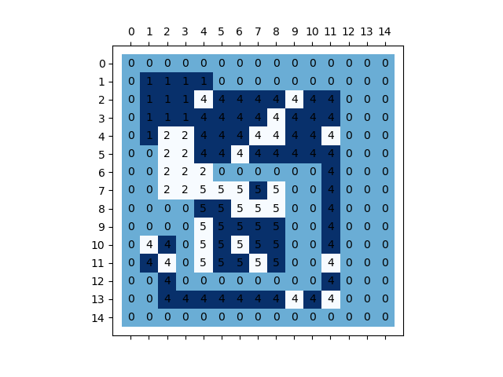
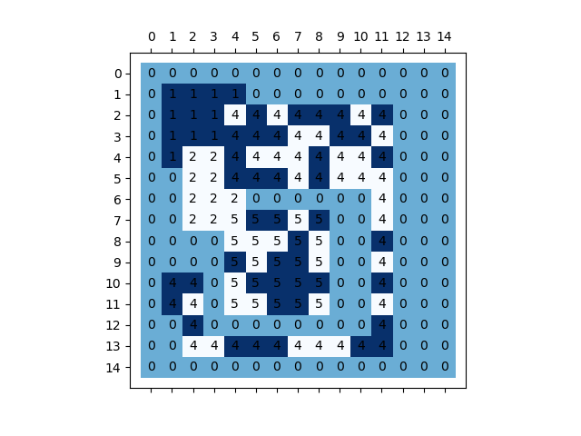
Game of Pure discoordination
In the following game payoffs are purely anti-coordination. The unique N.E’s are A,B and B,A, as well as a mixed strategy at E = .5A + .5B
Index:
0 = nothing
1 = always hawk
2 = always dove
3 = GRIM
4 = learning algorithm
5 = random
Observations: Observe the top left. 1 is always going to go A.
The learning algorithm notices this, and dis-coordinates with it.
2 will always dove, so 4 will typically hawk. Ripples spread
Through the learning algorithm from interaction between 1 and 2.

Slide 9
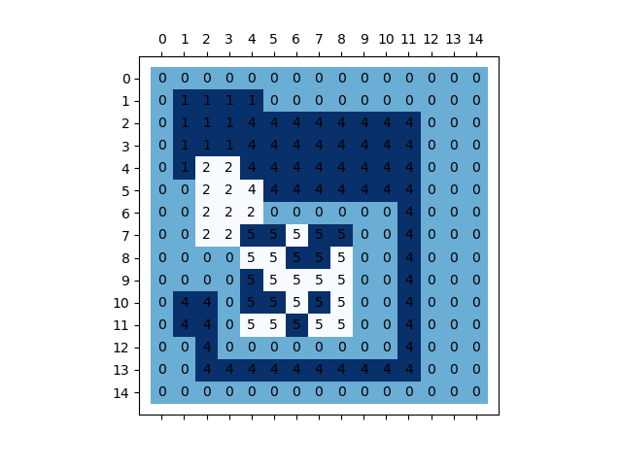
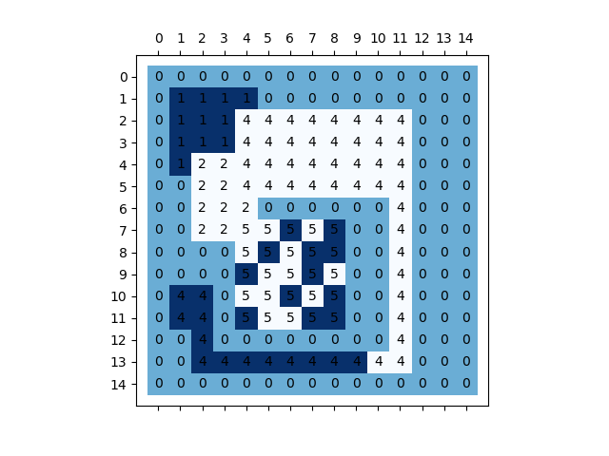
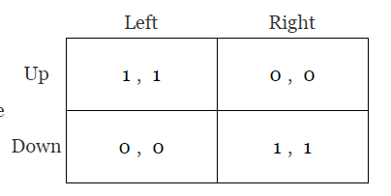
Game of Pure Coordination
In the following game payoffs are purely PRO-coordination. The unique N.E’s are A,A and B,B, as well as a mixed strategy at E = .5A + .5B
Index:
0 = nothing
1 = always hawk
2 = always dove
3 = GRIM
4 = learning algorithm
5 = random
Observations: The interaction between A and B has led to
The learning algorithm always choosing B. This is because on the
First 2 turns the learning algorithm always selects B to prevent
Premature movement. When I removed this restriction, it chose A
50% of the time, and could not easily switch between the two.
Barring statistical anomaly.

Slide 10
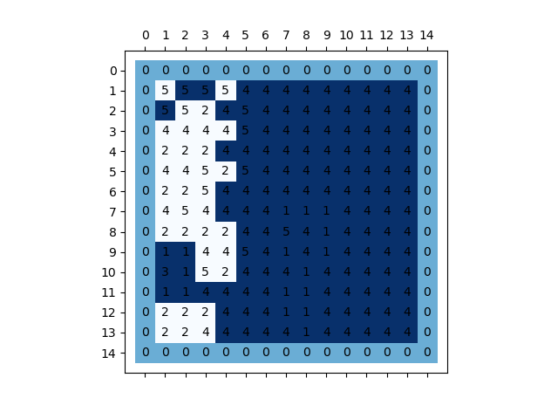
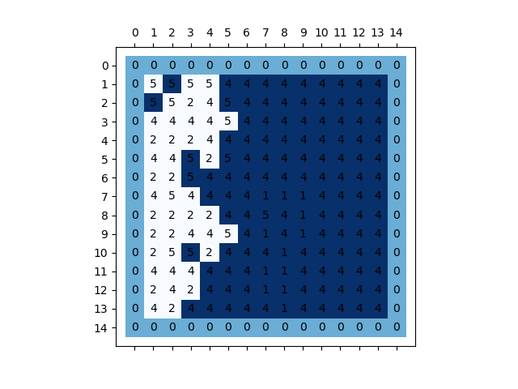
REVOLUTION!
In the following game payoffs are STILL purely PRO-coordination. The unique N.E’s are A,A and B,B, as well as a mixed strategy at E = .5A + .5B
Index:
0 = nothing
1 = always hawk
2 = always dove
3 = GRIM
4 = learning algorithm
5 = random
Observation: This is an example of a 2 “takeover”. Because this is a game
Of pure coordination with a Mixed N.E at 50%, the learning algorithm
will never switch to going option B unless there is a majority going B.
All of the white 4’s you see here are there because some unique interaction of
Surrounding 2’s and 4’s led to a majority being present. Remember, the learning
Algorithm is also biased towards A initially.

Slide 11
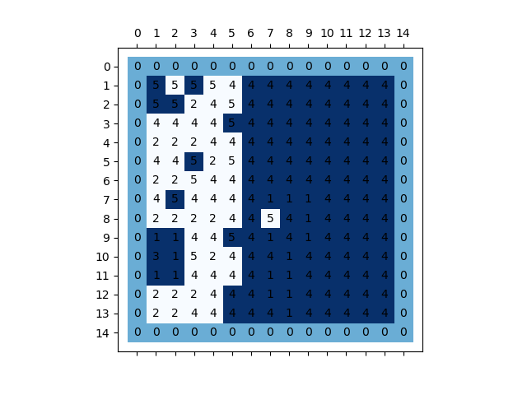
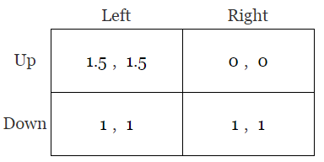
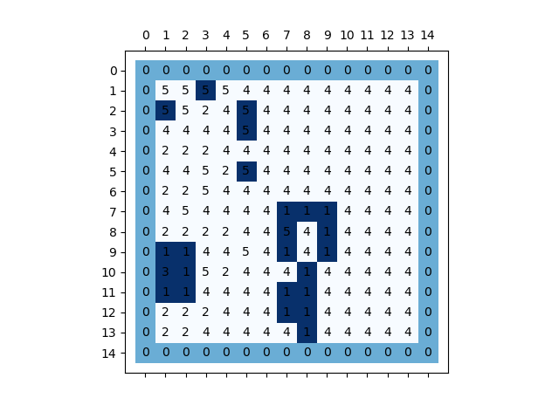
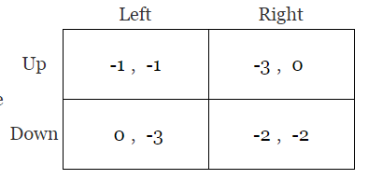
Revolution, but instead using stag hunt or prisoner’s dillemma
The difference in the stag hunt here is that the basin of attraction has changed. The Mixed NE is no longer .5A, but .66666A
The difference with the Prisoner’s Dillemma is that there is no basin of attraction on A, at all.

Slide 12
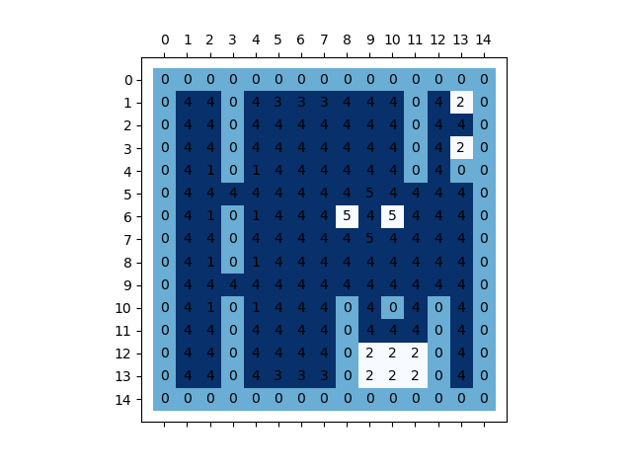
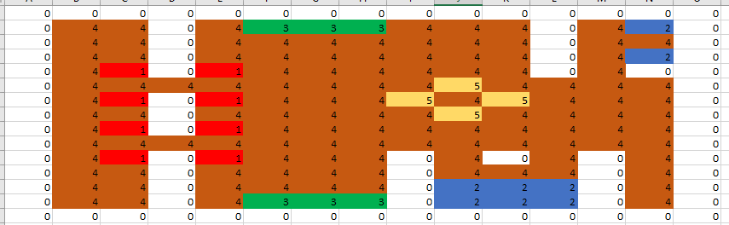
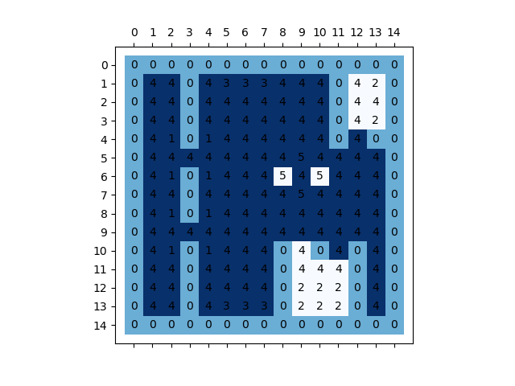
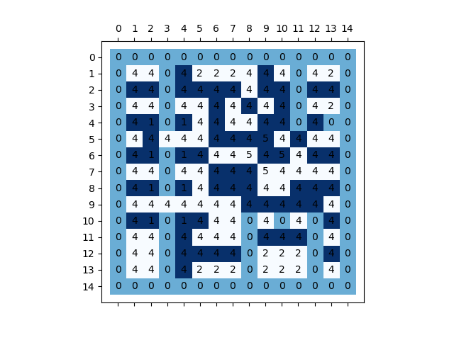
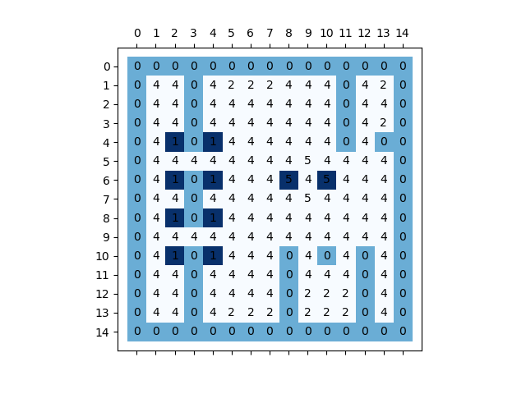
CASE STUDY
Pure Coordination
How do different games turn out in a semi-randomized map?
Stag Hunt
Dis-Coordination
Prisoner’s Dillemma

Slide 13
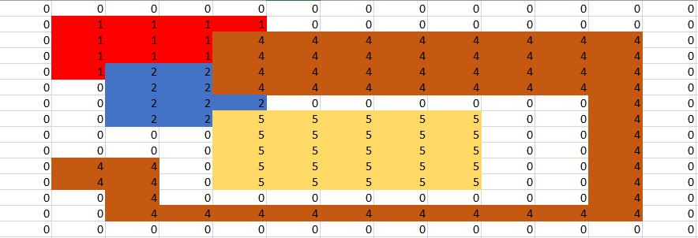
Build your own setup
Code is designed to take inputs from Data.txt, which is a tab and newline deliminated file. IT cleans the data and runs it. Could also be easily changed over to .csv format or similar. Excel copy & paste is newline and tab deliminated, which I found convenient.

Slide 14
Questions?

